Slide 1


CITS1003 Introduction to Cybersecurity [3] Introduction to Computer Architecture
Dr David Glance

Slide 2
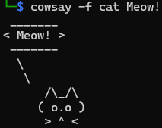
A unit about cats cybersecurity
Cowsay application on a Unix-like Operating System (Written by Tony Moroe in 1999)

Slide 3

Three things
Fundamentals and language of computer hardware and operating systems
How operating systems implement security
Fundamentals of networking and network security

Slide 4
Computers and Networks
Although we are focussed on general ideas around Cybersecurity, it is useful to at least have some understanding of computers and the networks they use to communicate over
We will look at PC architecture first in a generalised way and then the basics of how computer networks operate, especially TCP/IP, the network protocol of the Internet

Slide 5
PC Architecture
At one level of abstraction, a PC’s purpose is to run software applications
Applications are run by an Operating System: e.g. Windows, Linux MacOS
Before an Operating System can run, it needs to be loaded and started and this is the job of firmware or a “bootloader”. Firmware exists in devices like hard drives, network cards, sound cards, etc
This is all running on hardware: the components of the PC that store, execute and process inputs and outputs
Applications
Operating System
Firmware
Hardware

Slide 6
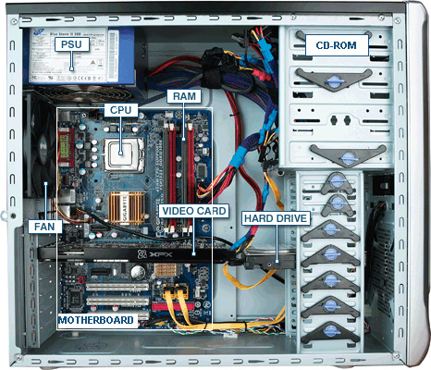
PC Hardware
CPU: Central processing unit
RAM: Random Access Memory
PSU: Power Supply Unit
Fan: Fan
Video Card
Hard Drive
Motherboard
Network card: Wired and/or Wireless (not shown)
http://tazalink.blogspot.com/

Slide 7
CPU
The CPU processes instructions and data that are stored in memory
Memory is either random access memory (RAM) or read only memory (ROM)
Instructions and data are transported between memory and the CPU over a Bus. Either:
Address Bus
Data Bus
Control Bus
The CPU can also read and write data from an Input/Output (I/O) device
Instructions that are processed by the CPU are simple operations like add, subtract, AND, OR, XOR, etc

Slide 8
Booting Up
When a computer is powered on, the firmware in ROM is loaded and run. This is the BIOS (Basic Input Output System).
The BIOS will run a Power-On Self Test (POST) to check for hardware components like a display, keyboard, network card, memory.
The BIOS will then load the first 512 bytes from the hard drive called the Master Boot Record (MBR) This contains the bootloader code that will execute and load the operating system

Slide 9
Operating System
The operating system is responsible for a number of different tasks
Running and scheduling applications to run and share resources such as CPU, Disk, RAM
Allows for memory virtualization
Controlling access to I/O devices through I/O Driver software
Manage access control and authentication
Handle communication via networks
Handles graphical user interfaces

Slide 10
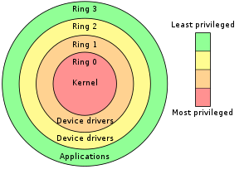
Kernel
The CPU operates in different modes: user mode and supervisor mode
Applications are run in different protective rings organised from the most secure and privileged in Ring 0 to application level code in Ring 4
Applications that are scheduled to run are prioritised depending on which ring they run in: Most privileged applications have priority
Organising the kernel in Ring 0 is a protection mechanism to allow only trusted code to run there

Slide 11
Command Shell
Users and Applications can interact with the kernel through system calls via Application Programming Interfaces (APIs) in software code, or via executing shell commands
The shell provides a command-line interface to interact with the system
Shell commands can be used to launch programs, manage filesystems, change system settings, manage permissions and other tasks
Common Windows shells include PowerShell and CMD
Common Linux/Unix-like shells include Bash, zsh, and FiSH

Slide 12
Shell vs Terminal
A Terminal is a command-line interface that can be used to interact with a shell
The window that handles inputs and outputs
Allows users to type commands, copy/paste, send interrupt codes etc.
A Shell is the system that interprets and executes your commands
Provides a language of commands that can be used
Allows users to execute programs

Slide 13
Shell Commands
Bash (Linux or MacOS Terminal) | PowerShell | CMD | Description
ls | ls or dir | dir | List files in current directory
cd | cd | cd | Change Directory
cp | cp or copy | copy | Copy a file from one place to another
mv | mv or move | move | Move or rename a file
mkdir | mkdir | mkdir | Create directory (folder)
rm | rm or del | del | Delete a file
cat | cat or type | type | Print the contents of a file (or concatinate files)

Slide 14
Shell Commands
Most shell commands are actually programs that get executed
The shell runs the program and assigns it to a process and passes control of the terminal to the program while it is running

Slide 15
Command Arguments
Command Arguments are strings of text that are provided to a command or program to be used in its execution
This information might be something like a filename or a path
Eg. cat secretmessage.txt
Arguments that start with - or -- are often “command flags” that set options for the program
Eg. gpg -e --armor secretmessage.txt

Slide 16
File Systems
A file:
Is a named collection of information stored on a storage device such as a internal disk drive or external USB drive
Has metadata such as name, type, location, size, protection, creator, creation time, etc
Has an owner and permissions for access control
Organised in directories or folders
Operating system supports a file system which is a way of organising files on a disk, providing operations of creating, reading, writing and deleting files
Devices can be logically viewed as files as well
Numerous file system types: FAT, NTFS, APFS, EXT etc
Access is controlled by discretionary and role based access control

Slide 17
Windows vs Unix-like Style
Windows filesystems are structured around drives or devices that are “mounted” at the root of the file system.
The primary system hard drive is usually labelled C:\ with other drives given other letters
The filesystem is structured hierarchically within each drive.
C:\
users
Alice
Desktop
Program Files
Mozilla
Pictures
Downloads
Firefox
D:\
Bobs Stuff
Kali
Parrot
Password Lists

Slide 18
Windows vs Unix-like Style
Unix-like filesystems (Like Linux or MacOs) are structured in a single hierarchy with / as the root directory
The primary system is mounted as / with other devices able to be mounted at different locations
/
bin
dev
etc
lib
media
home
Alice
Desktop
Pictures
Downloads
Bobs stuff
Kali
Parrot
Password Lists
firefox
opt
proc
usr
var

Slide 19
Paths
The location of a file or directory can be represented by a “path” string.
In Windows, paths use \ (backslash) to delimit folders
Eg. C:\users\Alice\Desktop\hello.txt
In Linux and other Unix-like operating systems, paths use / (forwardslash) to delimit directories
Eg /home/bob/Desktop/hello.txt

Slide 20
Expansions
Some commands, arguments and paths can be shortened or aliased to make some tasks simpler
The current user’s home directory can be referred to as ~
Eg. ~/Desktop is the same as /home/Alice/Desktop
The current directory can be referred to as .
Eg. To print a file named hello in the current directory: cat ./hello.txt
The previous directory in the hierarchy can be referred to as ..
Eg. To copy a file from the current directory to the previous directory: cp ./hello.txt ../

Slide 21
Expansions
The * expansion can be used as a wild card in some operations to match similar text
Eg. To copy all .txt files from the Desktop directory to the Documents directory:
cp ~/Desktop/*.txt ~/Documents/

Slide 22
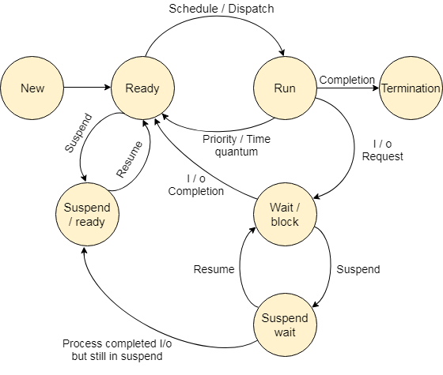
Processes
The operating system is responsible for running programs and managing their access to system resources
When a program is running it is known as a process and multiple processes may be running at the same time
The process may be in a number of different states depending on what actions it is performing or whether it has used up its time quantum

Slide 23
Process States
State | Description
Start | This is the initial state when a process is first started/created.
Ready | The process is waiting to be assigned to a processor. Ready processes are waiting to have the processor allocated to them by the operating system so that they can run. Process may come into this state after Start state or while running it by but interrupted by the scheduler to assign CPU to some other process.
Running | Once the process has been assigned to a processor by the OS scheduler, the process state is set to running and the processor executes its instructions.
Waiting | Process moves into the waiting state if it needs to wait for a resource, such as waiting for user input, or waiting for a file to become available.
Exit | Once the process finishes its execution, or it is terminated by the operating system, it is moved to the terminated state where it waits to be removed from main memory.
Processes are scheduled by the operating system according to one of a number of different algorithms
Processes may run at the same time if the computer has multiple processors
Simultaneous execution can happen through multithreading
A lightweight version of a process

Slide 24
Process Attributes
Process ID (pid): A process is uniquely identified by a numeric identifier
Parent: All processes are started by another process and so maintains links to their parent and may inherit attributes such as open files and access to terminals
Parent processes are identified by the Process Parent ID (ppid)
Files: Processes work on files (and devices that are represented as files) and so information about these are kept for each process
Virtual Memory: A process is allocated memory to store the code and data that it operates on. If this becomes too large for physical memory, it may be mapped to disk

Slide 25
Daemons and Services
Some long-running processes are designed to run without a user interface.
Programs that don’t require user interaction like web servers or file servers
Processes that handle system settings and features like NTP or DHCP
In Unix-like operating systems, these background processes are called “Daemons”
In Windows, these background processes are generally called “Services” and are handled by svchost.exe.
Some background services in windows instead have their own processes and may run in the system tray.

Slide 26
Users
Each process has a PID to identify it, but each user account also has a User Id (UID) to identify that user
When a process runs, the UID of the user that ran the process is associated with the process
The process will inherit permissions from the user that ran it for Access Control (Authorization)

Slide 27
Users
User accounts are created, not only for people, but also for daemons
User accounts for people allow users to log in and access a shell and/or a GUI
User accounts for daemons generally do not allow interactive logins and instead the daemons are controlled by an init system within the operating system
All user accounts should follow the Rule of Least Privelege

Slide 28
root
There is an account that has full permissions for all possible tasks in the application ring of the kernel
The Root user in Unix-like operating systems has full permissions to do anything that it is possible for a user to do (it can’t do e.g. ring 0 kernel tasks though)
In Windows, the Administrator fills that role with the SYSTEM user having even more control but no interactive logins

Slide 29
Sudo/UAC
Administrators generally also use restricted user accounts and do not log in as either root or Administrator
They do not need to perform admin tasks all the time and only need temporary permissions to access things
Instead, an administrator account can request for temporary superuser permissions to perform admin tasks by using sudo
Windows uses the User Account Control prompt which can be invoked via the “Run as Administrator” option

Slide 30
Access Control
Access control restricts who has access to an object (e.g. file) and what operations they may perform on it. Different types:
Discretionary Access Control (DAC)
Mandatory Access Control (MAC)
Role-Based Access Control (RBAC)
Rule-Based Access Control
Attribute Based Access Control

Slide 31
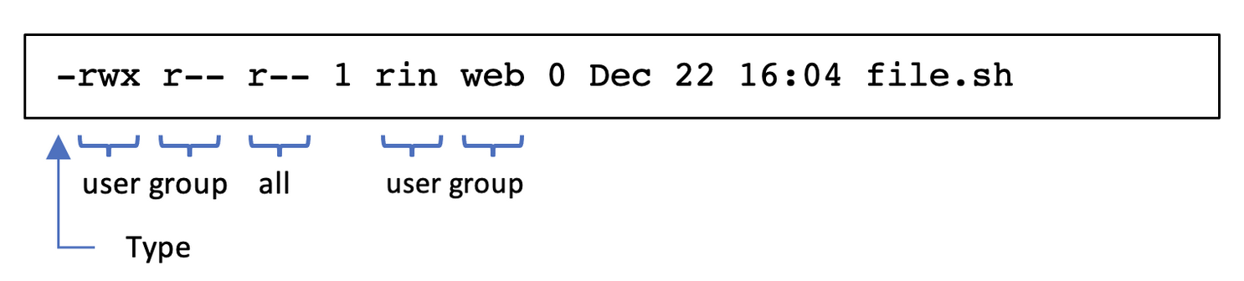
DAC and RBAC
Discretionary Access Control (DAC): Each object has an owner who grants access to other users
Linux and Windows file systems use this along with role based access control
Role-Based Access Control (RBAC): Access is granted by administrators to groups of users based on their roles or Groups
In Linux: operations are r (read), w (write), x (execute) and are set on each file and directory

Slide 32
Rules, ABAC and MAC
Rule-Based Access Control: Access is granted based on rules/policies
Firewalls use this type of access control
Cloud Services object storage also uses policies to grant access
Attribute Based Access Control (ABAC): Access granted based on attributes (device, location, time of day)
Networks such as WiFi that restrict access based on MAC address or time of day
”Allow access from mobile devices”
Mandatory Access Control (MAC): Access is granted based on labels assigned to the user and the object.
Used in situations where access is determined by security level e.g. Top-Secret vs Secret

